Slide 1
GANTT CHART
Developed by Harvey Gantt in 1917, Gantt charts are another extremely useful tool for creating a project network.
Gantt charts establish a time-phased network that links project activities to a project schedule baseline.
They can also be used as a project tracking tool to assess the difference between planned and actual performance.
Activities are ordered from first to last along a column on the left side of the chart with their ES and EF durations drawn horizontally.
The ES and EF dates correspond to the baseline calendar drawn at the top of the figure.

Slide 2
GANTT CHART
Some time Gantt chart referred to horizontal bar charts, Gantt charts may be used to plan the time scale for a project and to estimate the amount of resources required.
In simpler form the Gantt chart is used to show the time to be aken for each activity, which commences at the appropriate stage in the project plan.
As the activity is achieved the bar is shaded in and by using a data cursor it is easy to se if the time scale is being adhered to .
Alternatively , an actual and estimated split bar can be used.

Slide 3
GANTT CHART
Gantt charts represent one of the first attempts to develop a network diagram that specifically orders project activities by baseline calendar dates, allowing the project team to be able to focus on project status at any date during the project’s development.
SOME BENEFITS OF GANTT CHARTS ARE:
(1) they are very easy to read and comprehend,
(2) They identify the project network coupled with its schedule baseline,
(3) they allow for updating and project control,
(4) they are useful for identifying resource needs and assigning resources to tasks, and
(5) they are easy to create.

Slide 4
1. Comprehension—Gantt charts work as a precedence diagram for the overall project by linking together all activities. The Gantt chart is laid out along a horizontal time line so that viewers can quickly identify the current date and see what activities should have been completed, which should be in progress, and which are scheduled for the future. Furthermore, because these activities are linking in the network, it is possible to identify predecessor and successor activities.
2. Schedule baseline network—The Gantt chart is linked to real-time information, so that all project activities have more than just ES, EF, LS, LF, and float attached to them. They also have the dates when they are expected to be started and completed, just as they can be laid out in
conjunction with the overall project schedule.

Slide 5
3. Updating and control—Gantt charts allow project teams to readily access project information activity by activity. Suppose, for example, that a project activity is late by 4 days. It is possible to on a Gantt chart to update the overall network by factoring in the new time and seeing a revised project status. Many firms use Gantt charts to continually update the status of ongoing activities. Gantt charts allow managers to assess current activity status, making it possible to begin planning for remedial steps in cases where an activity’s completion is lagging behind expectations.
4. Identifying resource needs—Laying the whole project out on a schedule baseline permits the project team to begin scheduling resources well before they are needed, making resource planning easier.
5. Easy to create—Gantt charts, because they are intuitive, are among the easiest scheduling devices for project teams to develop. The key is having a clear understanding of the length of activities (their duration), the overall precedence network, the date the project is expected to begin, and any other information needed to construct the schedule baseline, such as whether overtime will be needed.

Slide 6
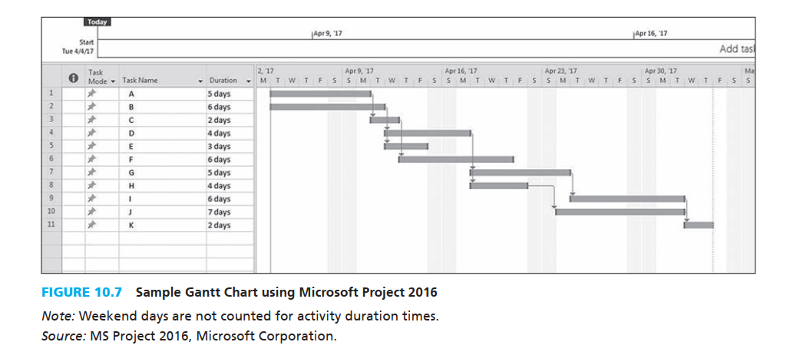

Slide 7
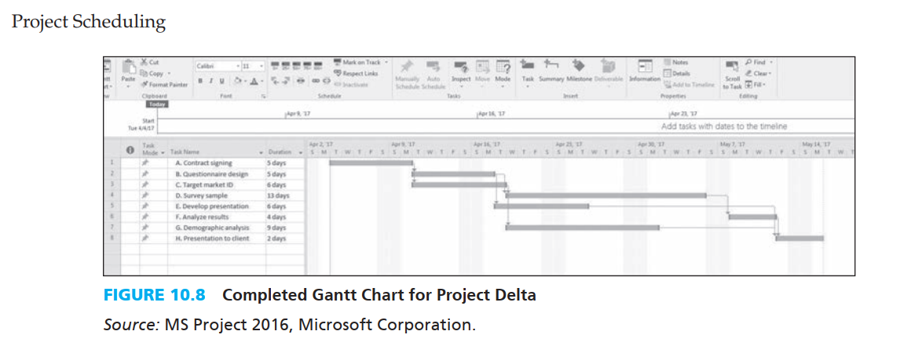

Slide 8
The start and finish dates and length are ascribed to each activity and represented by the horizontal bar drawn from left to right through the network. The chart lists the early activities in order from top to bottom.
The overall “flow” of the chart moves from the top left corner down to the bottom right. The baseline schedule is shown horizontally across the top of the page. Each activity is linked to indicate precedence logic through the network. All activities are entered based on their early start (ES) times.
We can adjust the network to change the logic underlying the sequencing of the tasks. For example, the activities can be adjusted based on the late start (LS) date or some other convention.

Slide 9
Activity slack is represented by the long arrows that link activities to their successors. For example, activity E, with its 60 days (12 weeks) of slack or float, is represented by the solid bar showing the activity’s duration and the lengthy arrow that connects the activity to the next task in the network sequence (activity H).
A number of software-generated Gantt charts will also automatically calculate the critical path, identifying the critical activities as the chart is constructed.

Slide 10
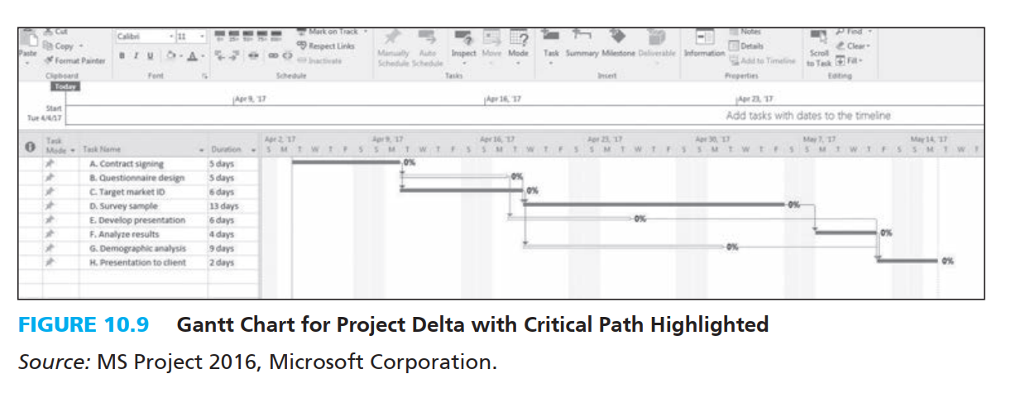
Gantt Chart for a project with Critical path

Slide 11
ADDING RESOURCES TO GANTT CHART
Adding resources to the Gantt chart is very straightforward, consisting of supplying the name or names of the resources that are assigned to perform the various activities.
Figure 10.10 gives an MS Project output showing the inclusion of a set of project team resources assigned to the various tasks.
It is also possible to assign the percentage of time each resource is assigned to each activity.
This feature is important because, it forms the basis for tracking and control of the project, particularly in terms of cost control.

Slide 12
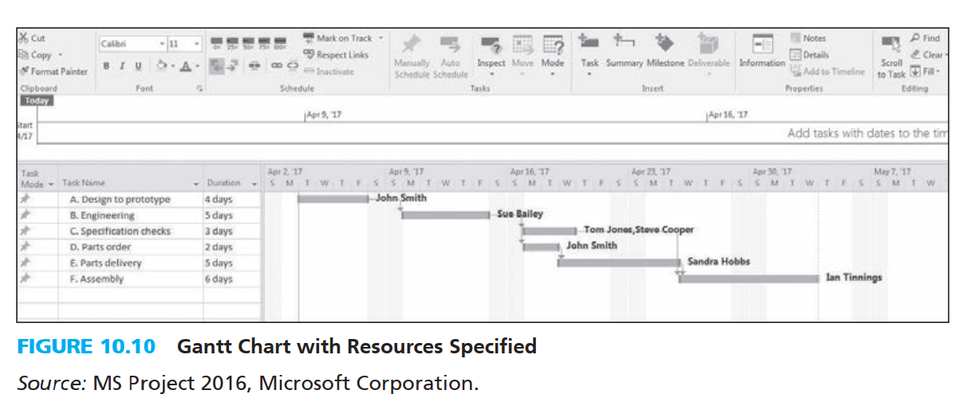
Gantt Chart with Resources Specified

Slide 13
INCORPORATING LAGS IN GANTT CHARTS
Gantt charts can be adjusted when it is necessary to show lags, creating a visual image of the project schedule.
Figure 10.11 is a Gantt chart with some alternative lag relationships specified. In this network, activities C (specification check) and D (parts order) are linked with a Finish to Finish relationship that has both ending on the same date.
Activity E is a successor to activities C and D, and the final two activities, E and F, are linked with a Start to Start relationship.
Similar to lag relationships in network construction, the key lies in developing a reasonable logic for the relationship between tasks.
Once the various types of lags are included, the actual process of identifying the network’s critical path and other pertinent information should be straightforward.

Slide 14
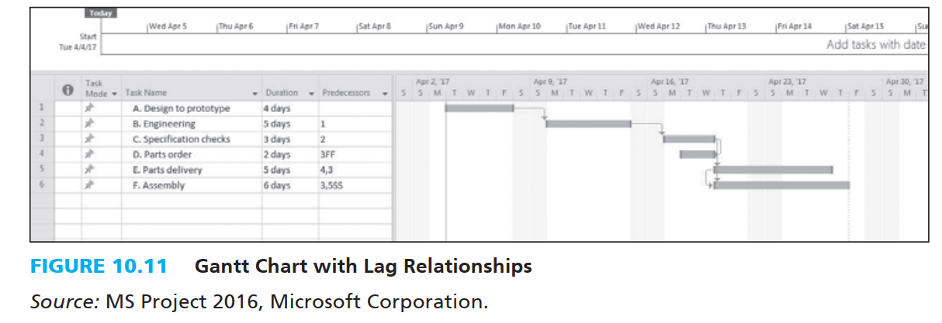
Gantt Chart with Lag Relationships

Slide 15
Creation of Gantt charts
List the steps required to complete the project.
Estimate the time required for each step
List the steps down the left hand side of the chart.
List the time intervals along the bottom of the chart.
Draw a horizontal bar to represent each activity.

Slide 16
Where steps can be carried out in parallel, this could give flexibility in the starting time of the shorter activity; it should be positioned as early as possible, but a dotted line might be used to show slack time,
Gantt charts are best used for fairly small projects and might be seen in the form of a wall chart on a project managers office rather than as a computer program.

Slide 17
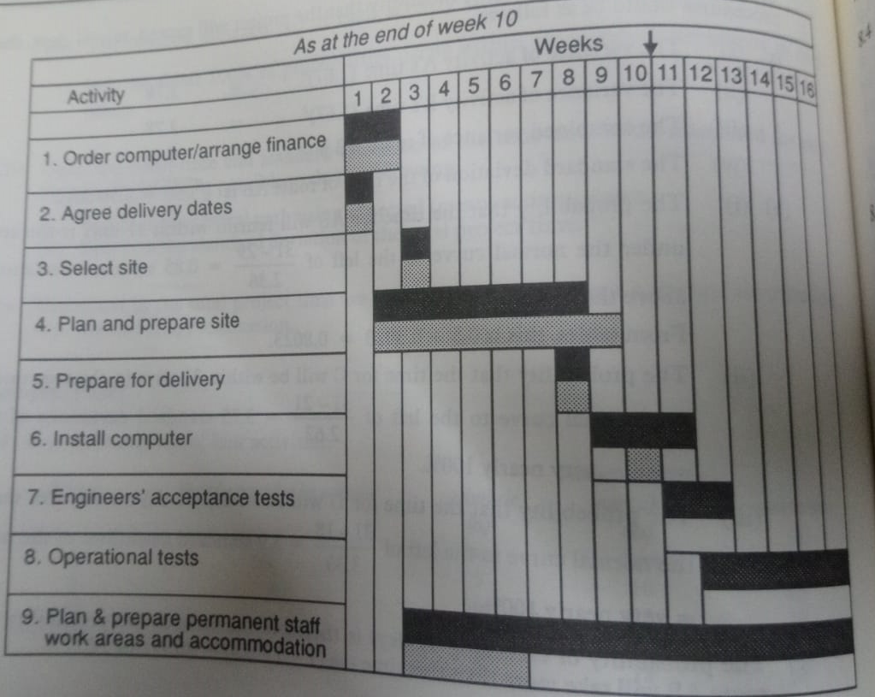
Gantt Chart

Slide 18
EXPLATION – AT THE END OF 10TH WEEK
At the end of 10th week Activity 9 is running behind the schedule and more resources may have to be allocated to this activity if the staff accommodation is to be ready in time for change over to the new system.
Activity 4 had not been completed on time , and this has resulted in some disruption to the computer installation.
Activity 6 which may mean further delays in the commencement of Activities 7 and 8.
One of the main problems with this type of Gantt chart is that it does not reflect the interrelationship between the various activities in the project as does a net work diagram.
However, a combination of Gantt charts and network analysis might be used for project planning and resources allocations.

Slide 19
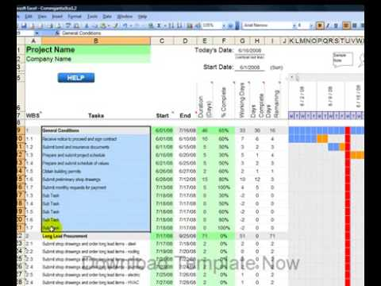
Gantt Chart
http://www.youtube.com/user/ConstructionOnline?v=y1IibpuT9GA&feature=pyv&ad=5354935710&kw=contractor%20schedule&gclid=COLg_qedkKQCFVBB6wodYDrQHg

